Slide 1
Chapter 1
The Philosophy of .NET

Slide 2
Objectives
Assemblies
Common Intermediate Language (CIL)
Just-in-time (JIT) compilation
Common Language Runtime (CLR)
Common Type System (CTS)
Common Language Specification (CLS)

Slide 3
Content
The .NET solution
The .NET Framework components.
Common Type System (CTS)
Common Language Specification (CLS)
Common Language Runtime (CLR)
.NET Assemblies
Home Reading

Slide 4
The .NET solution
Full interoperability with existing code
Complete and total language integration
A common runtime engine shared by all .NET-aware languages.
A base class library
No more COM plumbing
A truly simplified deployment model
Notes:
Component Object Model (COM) is a binary-interface standard for software components introduced by Microsoft in 1993. It is used to enable inter-process communication and dynamic object creation in a large range of programming languages
Plumbing:

Slide 5
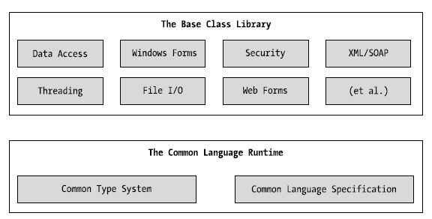
The .NET Framework components
The CLR, CTS, CLS, and base class library relationship

Slide 6
The role of the Base Class Libraries
Classes available to all .NET Framework languages
Various primitives:
  threads, file input/output, graphical rendering, interaction with
  external hardware devices
  database access, XML manipulation, security

Slide 7
Common Type System (CTS)
Types in .NET:
  Class: compose of any number of members and data points (fields)
  Structure: a lightweight class type
  Interface: a named collection of abstract member definitions
  Enumeration: allow to group name/value pairs
  Delegate: is equivalent of a type-safe function pointer

Slide 8
Common Type System (CTS)
CTS is a formal specification that documents how types must be defined in order to be hosted by the CLR
CTS defines various “adornments” that may be associated with a given member
Notes:
Adornment: tô điểm

Slide 9
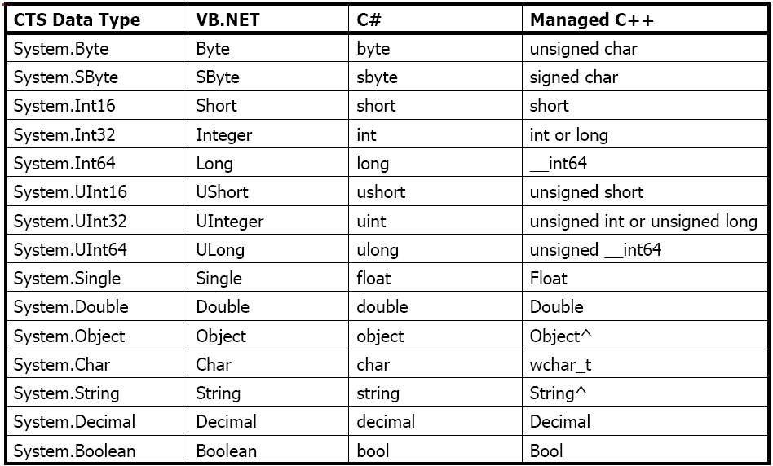
Intrinsic CTS Data Types

Slide 10
Common Language Specification (CLS)
CLS is a set of rules provided to:
  describe the minimal and complete set of feature Common Language Specification (CLS)s to produce code that can be hosted by CLR
  ensure that products of compilers will work properly in .NET environment
Sample rules:
  representation of text strings
  internal representation of enumerations
  definition of static members

Slide 11
Common Language Runtime (CLR)
CLR is physically represented by mscoree.dll library (Common Object Runtime Execution Engine)
  this library is loaded automatically when an assembly is referenced for use
CLR responsibilities:
  resolving the location of an assembly and finding the requested type within the binary by reading the contained metadata
  loading the type into memory
  compiling CIL into platform-specific instruction
  performing security checks „ executing the code

Slide 12
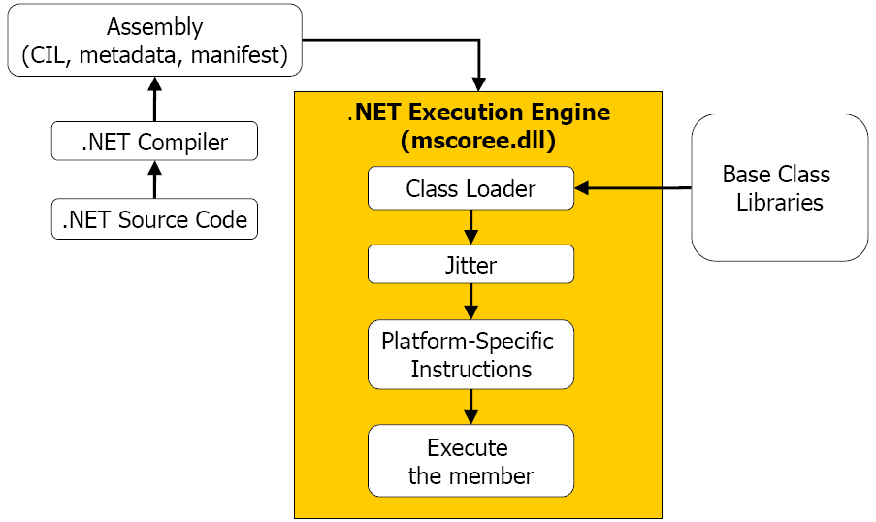
Common Language Runtime (CLR)
mscoree.dll in action

Slide 13
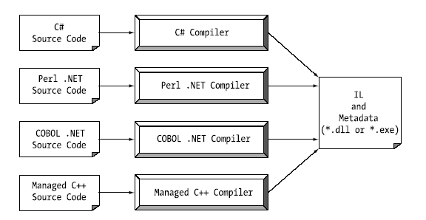
An overview of .NET Assemblies

Slide 14
An overview of .NET Assemblies
.NET Assemblies:
Binaries containing Common Intermediate Language (CIL)
instructions and type metadata
  dll or .exe files, which cannot be run without the .NET runtime
The most important features:
  establishing a type boundary
  versioning
  self-describing
  configurable

Slide 15
An overview of .NET Assemblies
.NET Assembly's Format:
  Win32 File Header
  CLR File Header
  CIL code
  type metadata
  assembly manifest
  optional embedded resource

Slide 16
Single-File and Multifile Assemblies
In a great number of cases, there is a simple one-to-one correspondence between a .NET assembly and the binary file (.dll or .exe)
  this is single-file assembly
Multifile assemblies are composed of numerous .NET binaries (modules)
  one of these modules (primary module) must contain the assembly manifest
  multifile assemblies allow to use more flexible deployment
  option (e.g. the user is forced to download only selected modules)

Slide 17
The role of the Common Intermediate Language (CIL)
Also known as Microsoft Intermediate Language (MSIL)
CIL is a language that sits above any particular platform- specific instruction set
  the same idea as Java's virtual machine
Compilers of all .NET-aware languages emit CIL instructions
  binaries are platform-independent
When the CIL code is about to run, the Jitter (just-in-time compiler) compiles it into native (machine) code
  Jitter will cache resulting machine code in memory

Slide 18
Benefits of CIL
Language integration
.NET program can run on numerous operating systems

Slide 19
The Assembly/Namespace/Type distinction
Namespace is a grouping of related types contained in an assembly
A single assembly can contain any number of namespaces

Slide 20
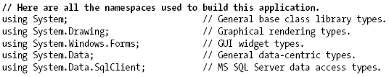
The Assembly/Namespace/Type distinction
Accessing a namespace programmatically

Slide 21
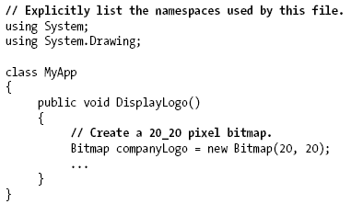
The Assembly/Namespace/Type distinction
Accessing a namespace programmatically

Slide 22
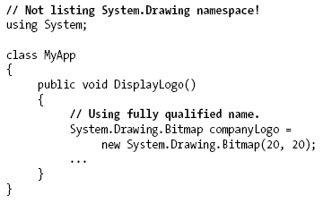
The Assembly/Namespace/Type distinction
Accessing a namespace programmatically

Slide 23
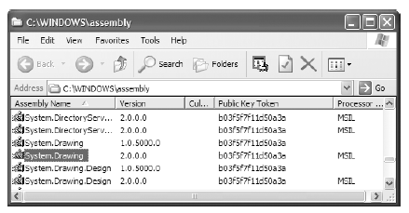
The Assembly/Namespace/Type distinction
Referencing external assemblies

Slide 24
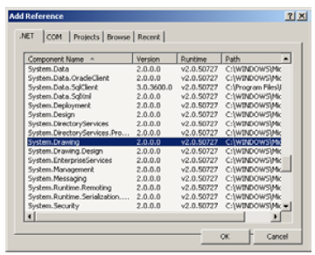
The Assembly/Namespace/Type distinction
To use types from external assembly:
  Add a reference to the project

Slide 25
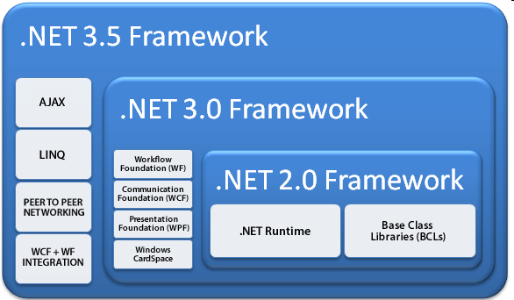
The relationships of the .NET Frameworks through version 3.5

Slide 26
Summary
The conceptual framework necessary for the remainder of textbook
Runtime execution engine and base class library
Assemblies
CIL and JIT compiler
The role of the CLS and CTS

Slide 27
Home Reading
What C# brings to the table (page 60)
Additional .NET-aware programming language (page 61)
Deploying the .NET runtime (page 82)

Slide 28
Q & A

